Slide 1
Sons of God:
Knowing the Father (part 2)
Eph 5:1-21, 1 Jn 2:3-6
09/04/17

Slide 2

Recap: Knowing the Father and make Him known (Acts 13:22)
And when He had removed him,
He raised up for them David as king,
to whom also He gave testimony and said,
‘I have found David the son of Jesse,
a man after My own heart,
who will do all My will.

Slide 3
After knowing more and more about who our Father in heaven is, we begin to know more about ourselves as sons.
Everything we receive as a son:
1) Salvation → Saviour
2) Protection/Provision/Progress → Father
“God is on the throne, He cares for His own”
Heb 21:6 - For the Lord disciplines the one he loves, and chastises every son whom he receives.
3) Kingship (rule & reign with Him) → King
the purpose is to make the Father known
John 17:26 - I made known to them your name, and I will continue to make it known, that the love with which you have loved me may be in them, and I in them.

Slide 4
A) We are built for something great
Personal breakthrough, revelation, prophetic words
1 Pet 2:9-10 = But you are a chosen race, a royal priesthood, a holy nation, a people for His possession, so that you may proclaim the praises of the One who called you out of darkness into His marvellous light. Once you were not a people, but now you are God's people; you had not received mercy, but now you have received mercy.
Rom 8:19
We are chosen to partner with God!

Slide 5
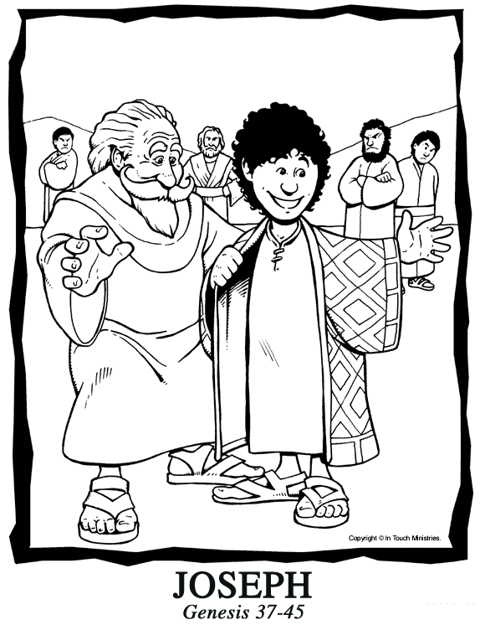
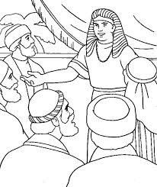
“Making of a prince” (Joseph)
1) We are prepared for something great

Slide 6
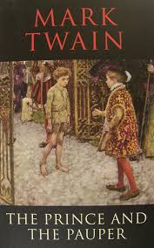
Are we a prince or a pauper?

Slide 7
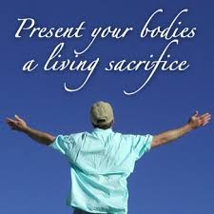
Living Sacrifices to God (Rom 12:1-2)
I beseech you therefore, brethren, by the mercies of God, that you present your bodies a living sacrifice, holy, acceptable to God, which is your reasonable service. And do not be conformed to this world, but be transformed by the renewing of your mind, that you may prove what
is that good and acceptable
and perfect will of God.

Slide 8
Take our relationship with God seriously
Eccl 12:13 – “Fear God and keep His commandments”
1 John 5:2 By this we know that we love the children of God, when we love God and keep His commandments. 3 For this is the love of God, that we keep His commandments.

Slide 9
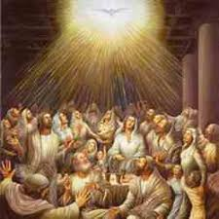
God chose 12 → 120 → 3000
Isa 6:8
Also I heard the voice of the Lord, saying:
“Whom shall I send,
And who will go for Us?
Then I said, “Here am I! Send me.”

Slide 10
God may raise up a man but takes a company of people to finish the work.
Abraham + 318 men (Gen 14:14)
David + 300 men (1 Sam 30)
Moses/Joshua + Israelites
Eph 6:12 For we do not wrestle against flesh and blood, but against principalities, against powers, against the rulers of the darkness of this age, against spiritual hosts of wickedness in the heavenly places.
A company of people to push back the darkness!

Slide 11
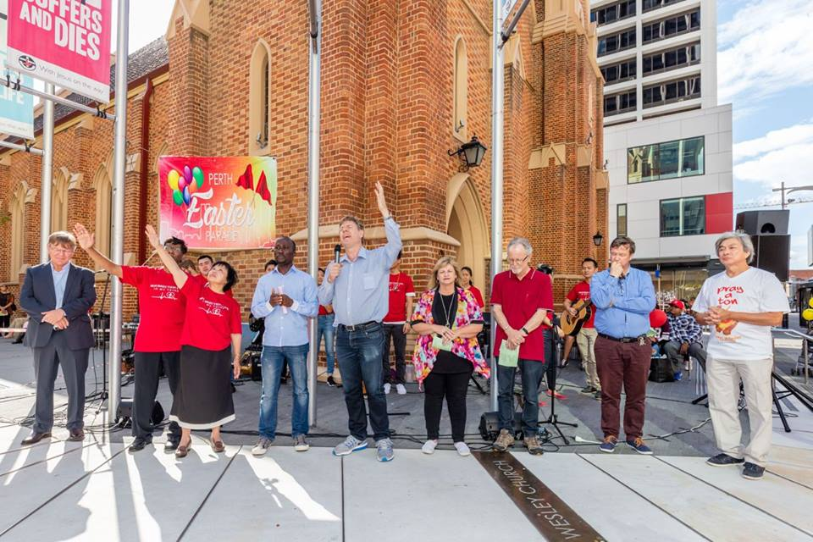
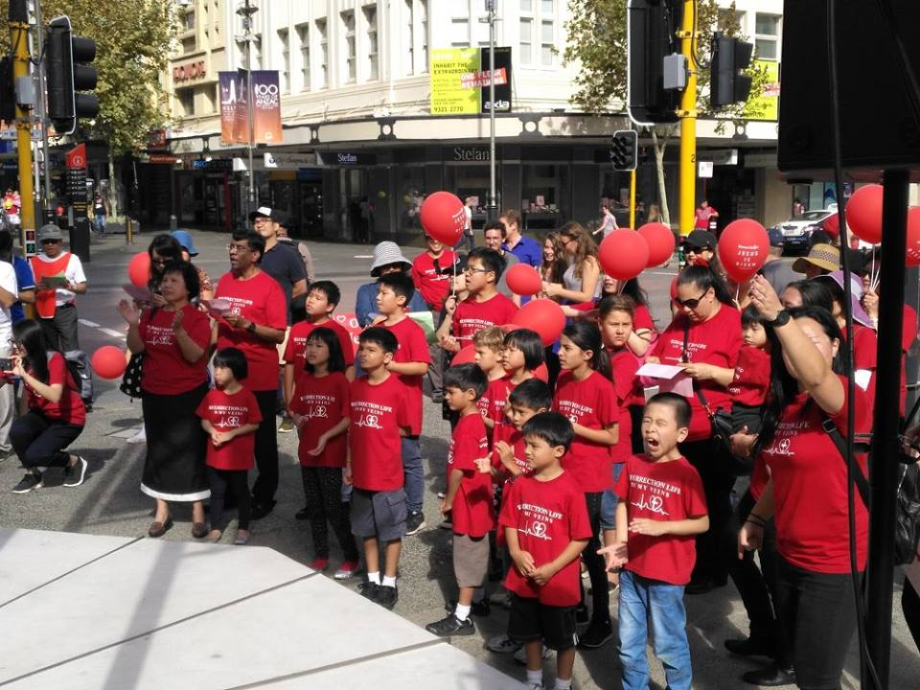
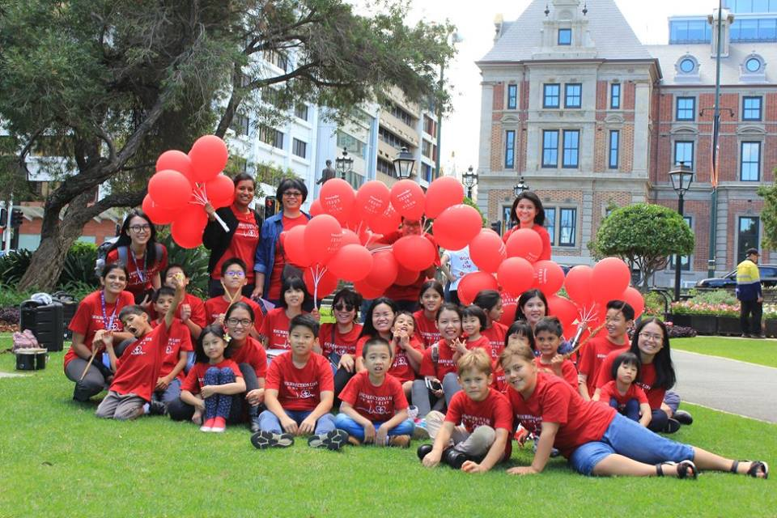
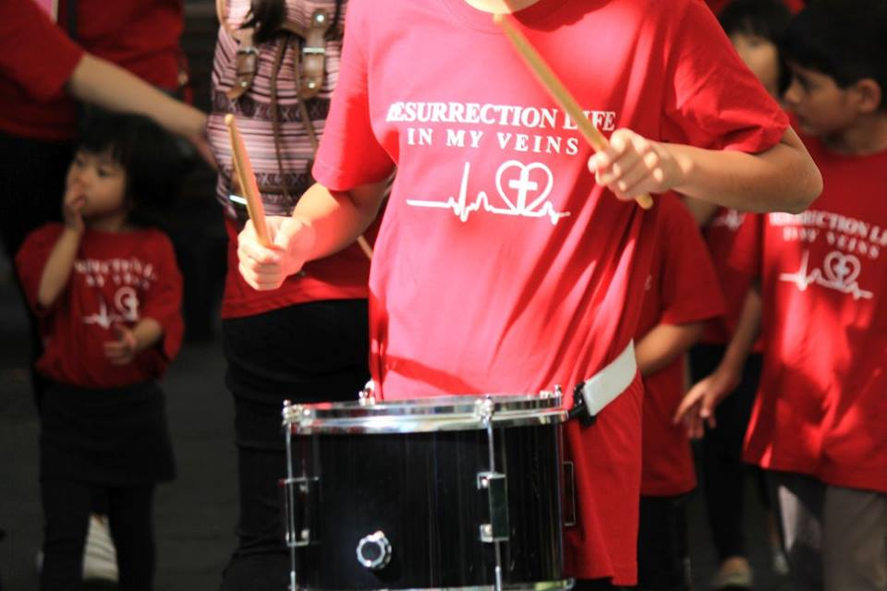

Slide 12
Conclusion…
Realise that we are prepared for something great
2) Only when we learn to honour covenantal relationship:
- God the Father
- Set man of the house (spiritual authority)
Brother and sister of the house (the Body)
can we positioned ourselves for city transformation

